Slide 1
OBJECT ORIENTED PROGRAMMING(IT-203) PRS PROJECT
CREATED BY : -
VARUN KUMAR (2K19/IT/140)
YASHIT KUMAR (2K19/IT/149)

Slide 2
BUS RESERVATION SYSTEM

Slide 3
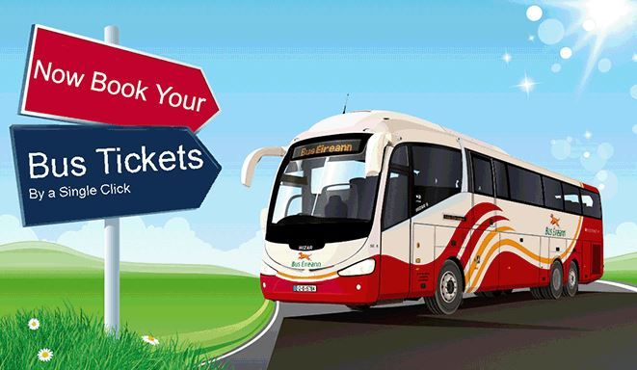

Slide 4
INTRODUCTION
Traveling is a large growing business across all countries. It includes maintenance of information like schedule and details of each bus.
We observed the working of the Bus reservation system and after going through it, we get to know that there are many operations, which they have to do manually. It takes a lot of time and causing many errors while data entry. Due to this, sometimes a lot of problems occur and they were facing many disputes with customers.
So we decided to make C++ console based application on Bus Reservation System

Slide 5
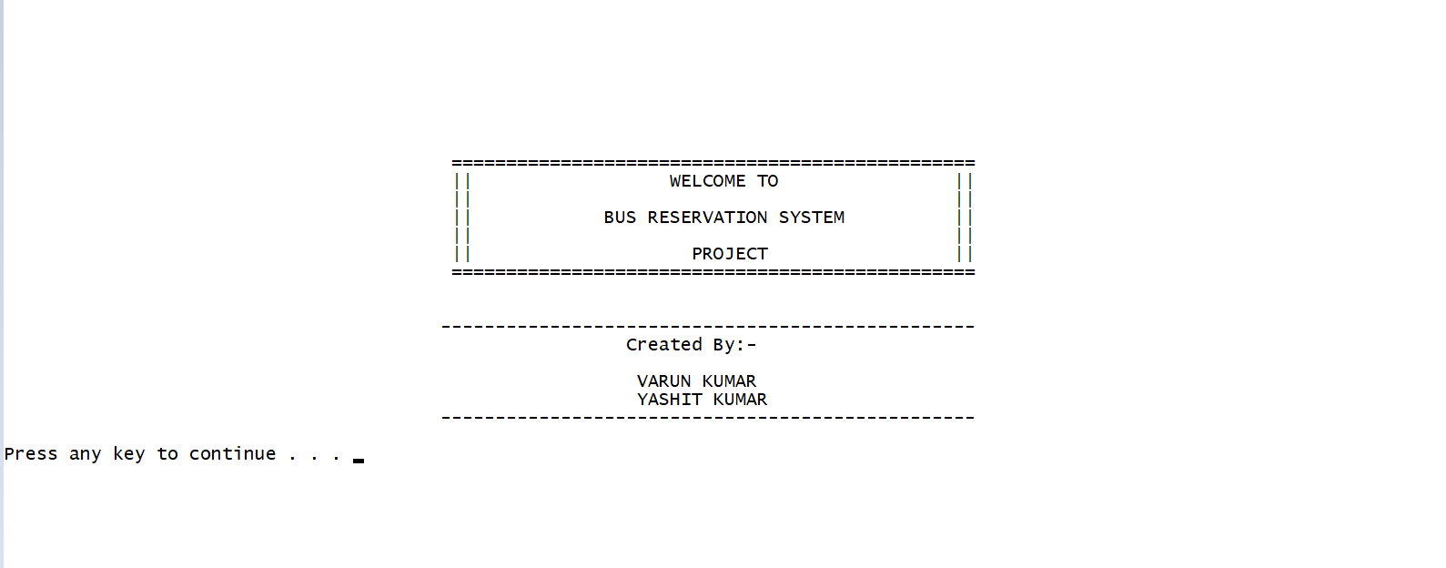

Slide 6
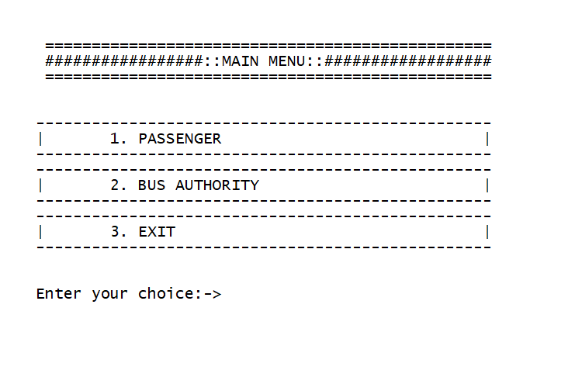
FEATURES OF OUR PROJECT
We have divided system into two portals : -
1. Passenger 2 .Bus Authority

Slide 7
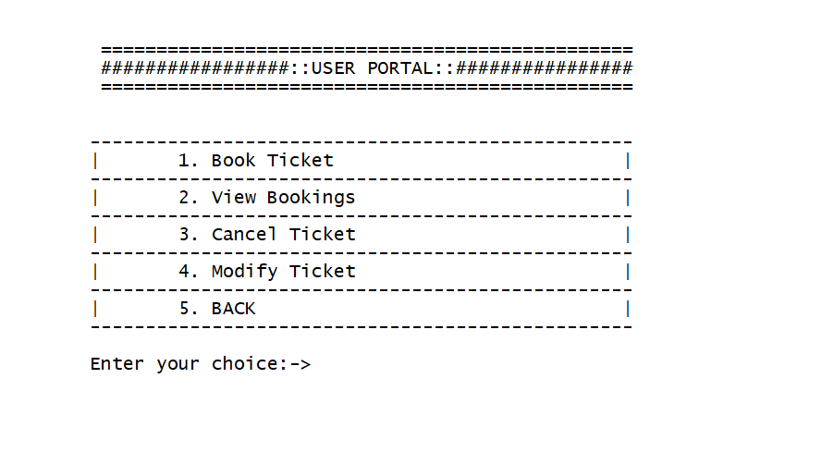
What Passenger can do ?
1 . Book a Bus Ticket
2. Can view his/her bookings
3. Can cancel Ticket
4. Can Modify Ticket

Slide 8
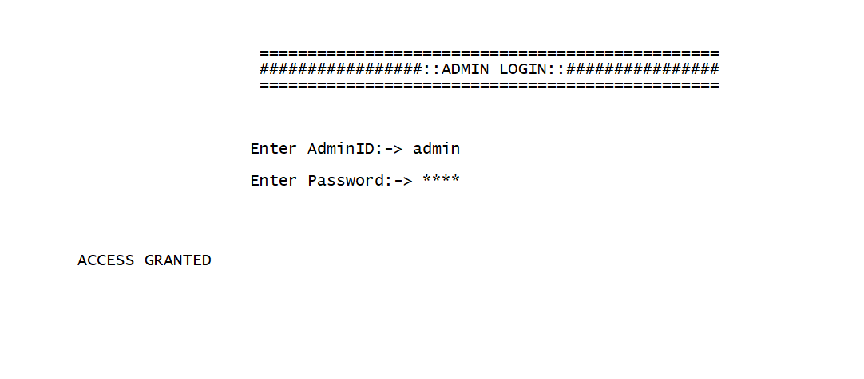
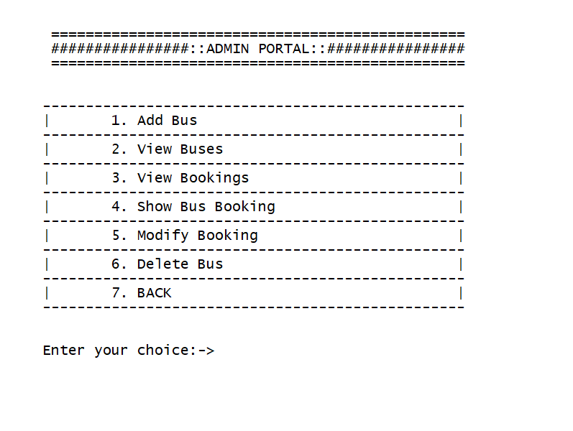
Bus Authority
1. Add Bus
2. View All Buses
3. View All Bookings
4. Show Bus Booking
5. Modify User Booking
6. Delete Bus

Slide 9
OOP CONCEPT USED
Abstraction - It is one of the most essential and important feature of object oriented programming in C++. Abstraction means displaying only essential information and hiding the details.
Classes Created :-
1. Bus
2. Customer
3. Admin
4. Ticket
Encapuslation - Encapsulation is defined as binding together the data and the functions that manipulates them.
All the four classes have this feature

Slide 10
Friend Function / Classes Used – A friend class can access private and protected members of other class in which it is declared as friend.
So we make class admin and ticket friend of class Bus so that admin can access Bus data
A friend function can be given special grant to access private and protected members
Functionality cancel ticket and modify ticket can be used by both admin class and customer so we make both the functions friend .
Exception Handling - A C++ exception is a response to an exceptional circumstance that arises while a program is running, such as an attempt to divide by zero
It is Used when admin try to enter the information about bus and enter invalid info and also it is used when the user is trying to enter wrong password at admin portal.
and also when Customer tries to enter invalid info
File Handling - File Handling is used to store the record of the user tickets and buses .

Slide 11
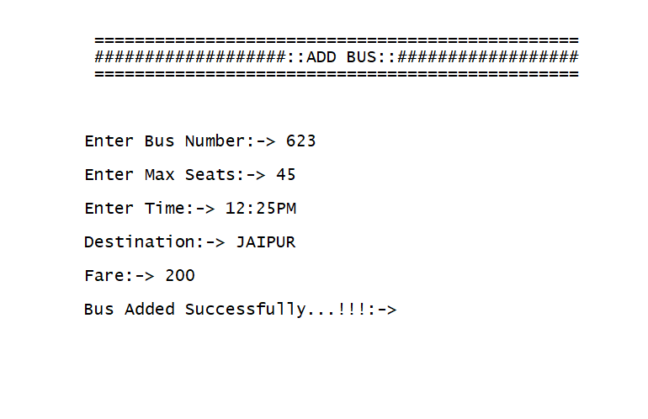
Working DEMO
Admin Installing Buses

Slide 12
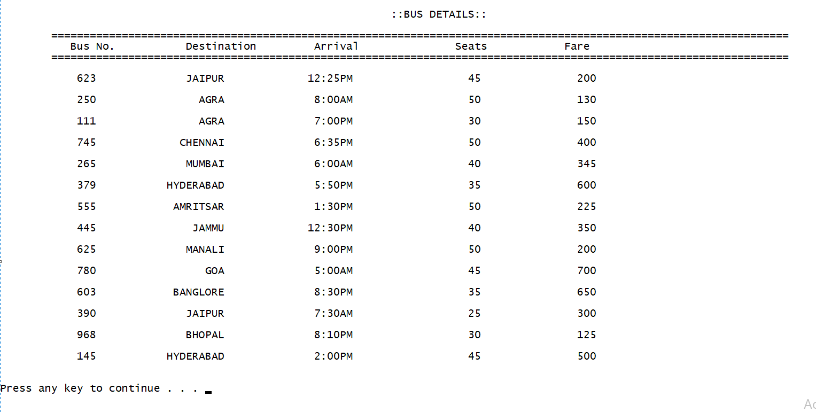
View all Buses via admin

Slide 13
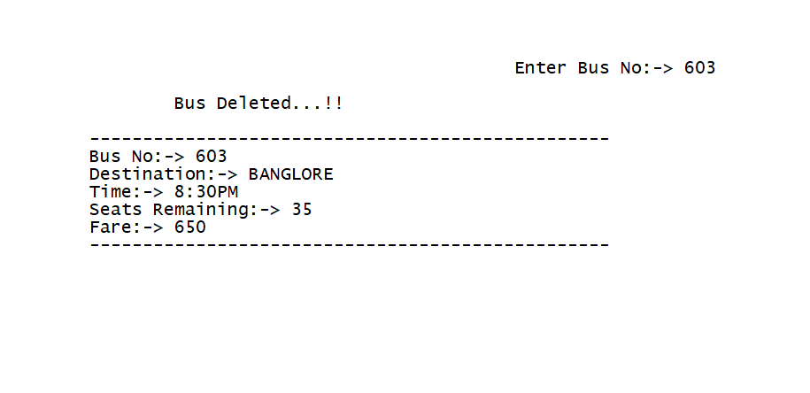
Admin can delete Bus

Slide 14
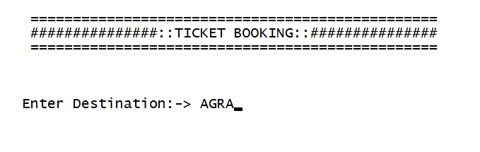
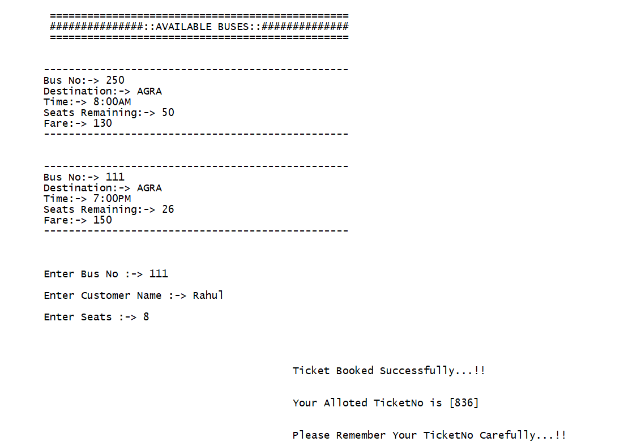
Passenger can Book Tickets

Slide 15
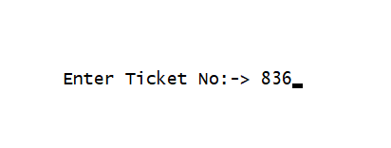
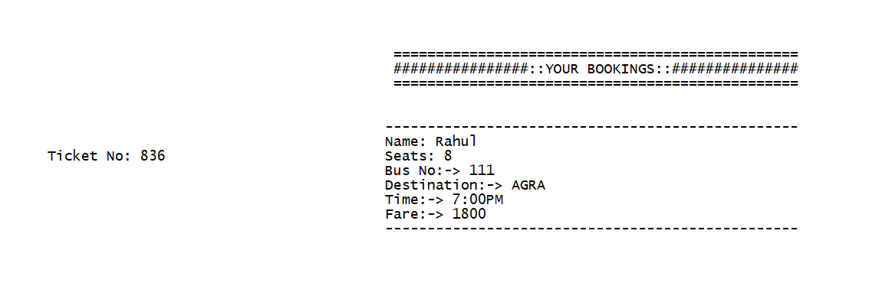
Passenger can view his Reserved Ticket

Slide 16
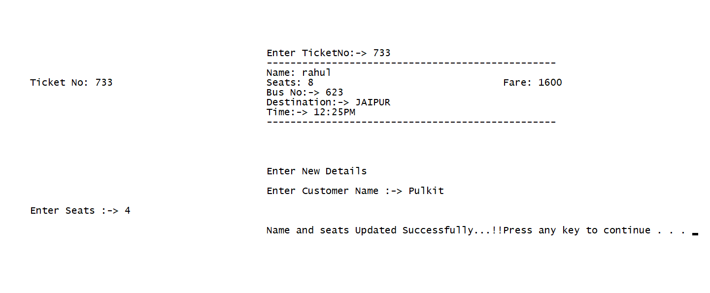
Passenger or Admin can modify his name and seats on ticket

Slide 17
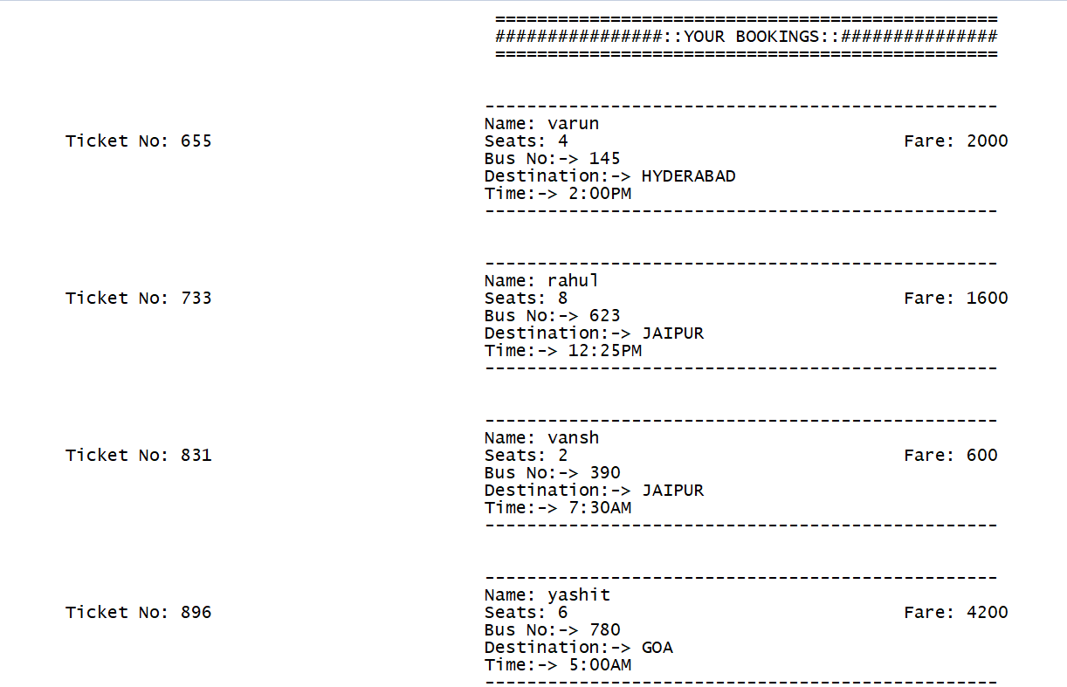
Admin can View all Bookings

Slide 18
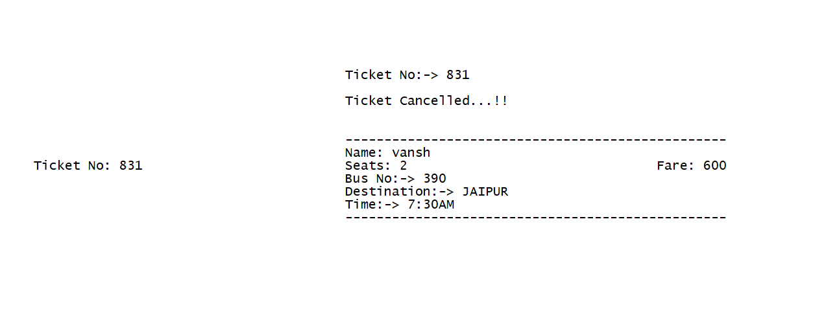
Passenger or Admin can cancel Ticket

Slide 19
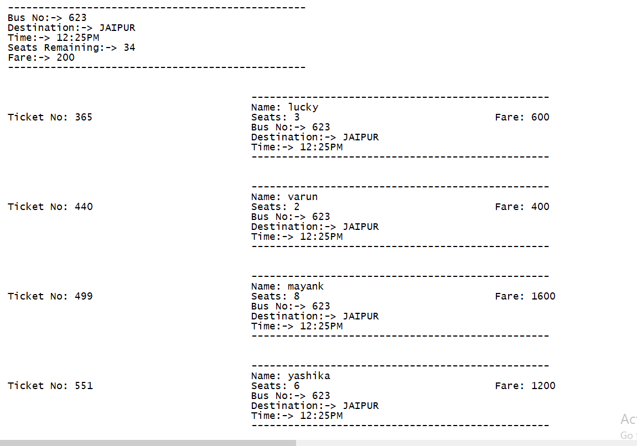
Admin can view a particular Bus Tickets

Slide 20
SOURCE CODE GITHUB LINK
https://github.com/varunkmr038/OOP-Project/blob/main/Bus%20Reservation%20System.cpp

Slide 21
BIBLIOGRAPHY
https://www.geeksforgeeks.org/object-oriented-programming-in-cpp/
Geetanjali Mam Notes
https://www.geeksforgeeks.org/friend-class-function-cpp/
https://www.geeksforgeeks.org/file-handling-c-classes/

